Slide 1


Slide 2
A Journey to the Future of Cloud-native Media Micro-services
Washington Cabral
M&E Client Technology Advisor
wcabral@br.ibm.com

Slide 3
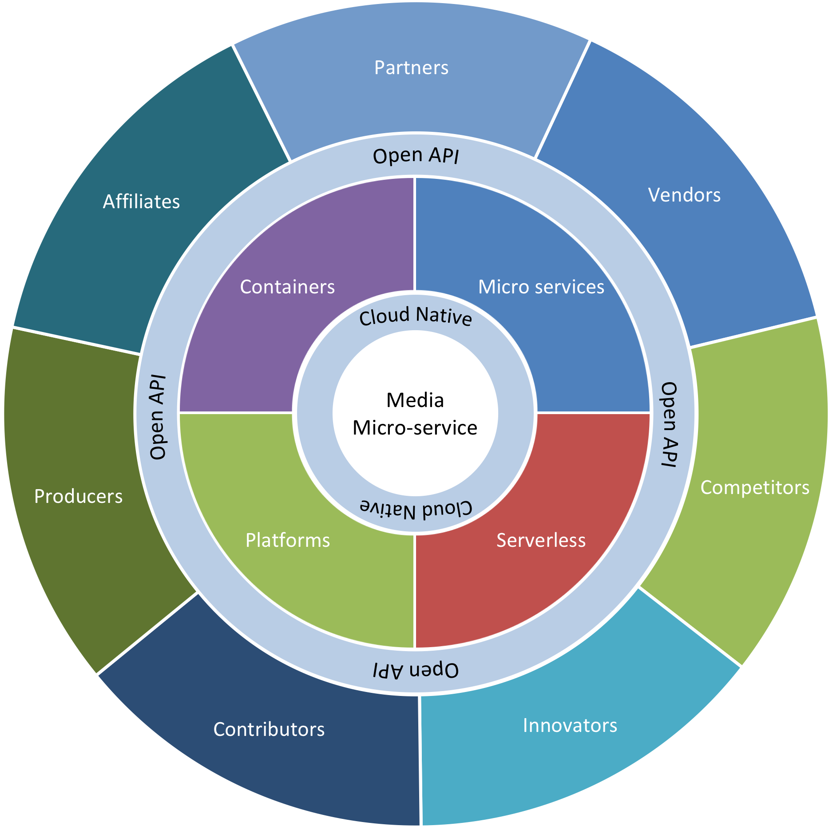
SERVERLESS
CLOUD-NATIVE
MEDIA MICRO-SERVICES
MEDIA SERVICE
CLOUD-NATIVE
MICRO-SERVICES
CONTAINERS
OPEN API
CN PLATFORM
Composable
media services
No geography
boundaries
Self service, resilient self healing systems
Vendor agnostic solutions,
priced down to the
minute

Slide 4
FIRST STOP: cloud-native
SERVERLESS
CLOUD-NATIVE
MEDIA MICRO-SERVICES
MEDIA SERVICE
CLOUD-NATIVE
MICRO-SERVICES
CONTAINERS
OPEN API
CN PLATFORM

Slide 5
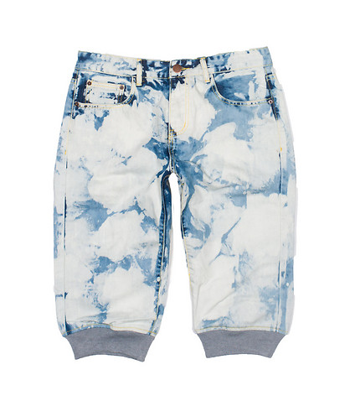
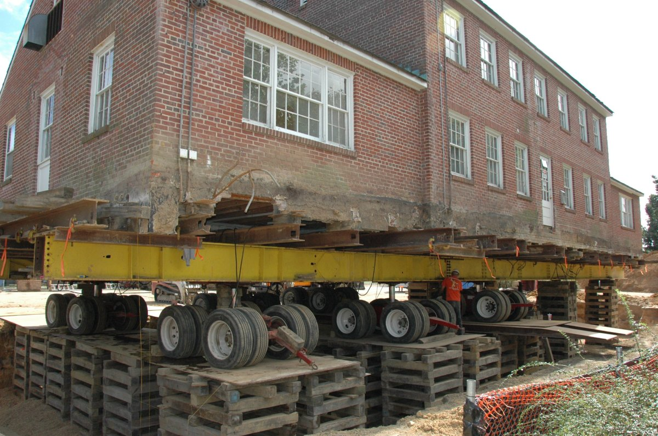

Being cloud-native is not about cloud-enable, cloud wash, lift and shift, virtualize…
http://cdnp.jimmyjazz.com/SH2930/SH2930_blue_decibel_cloud_wash_denim_jogger_short_lp1.jpg
https://alexandrebrisebois.files.wordpress.com/2014/12/lift-and-shift-5.jpg
http://aristonacademy.com/wp-content/uploads/2015/05/cloud-enabled-logo.png

Slide 6
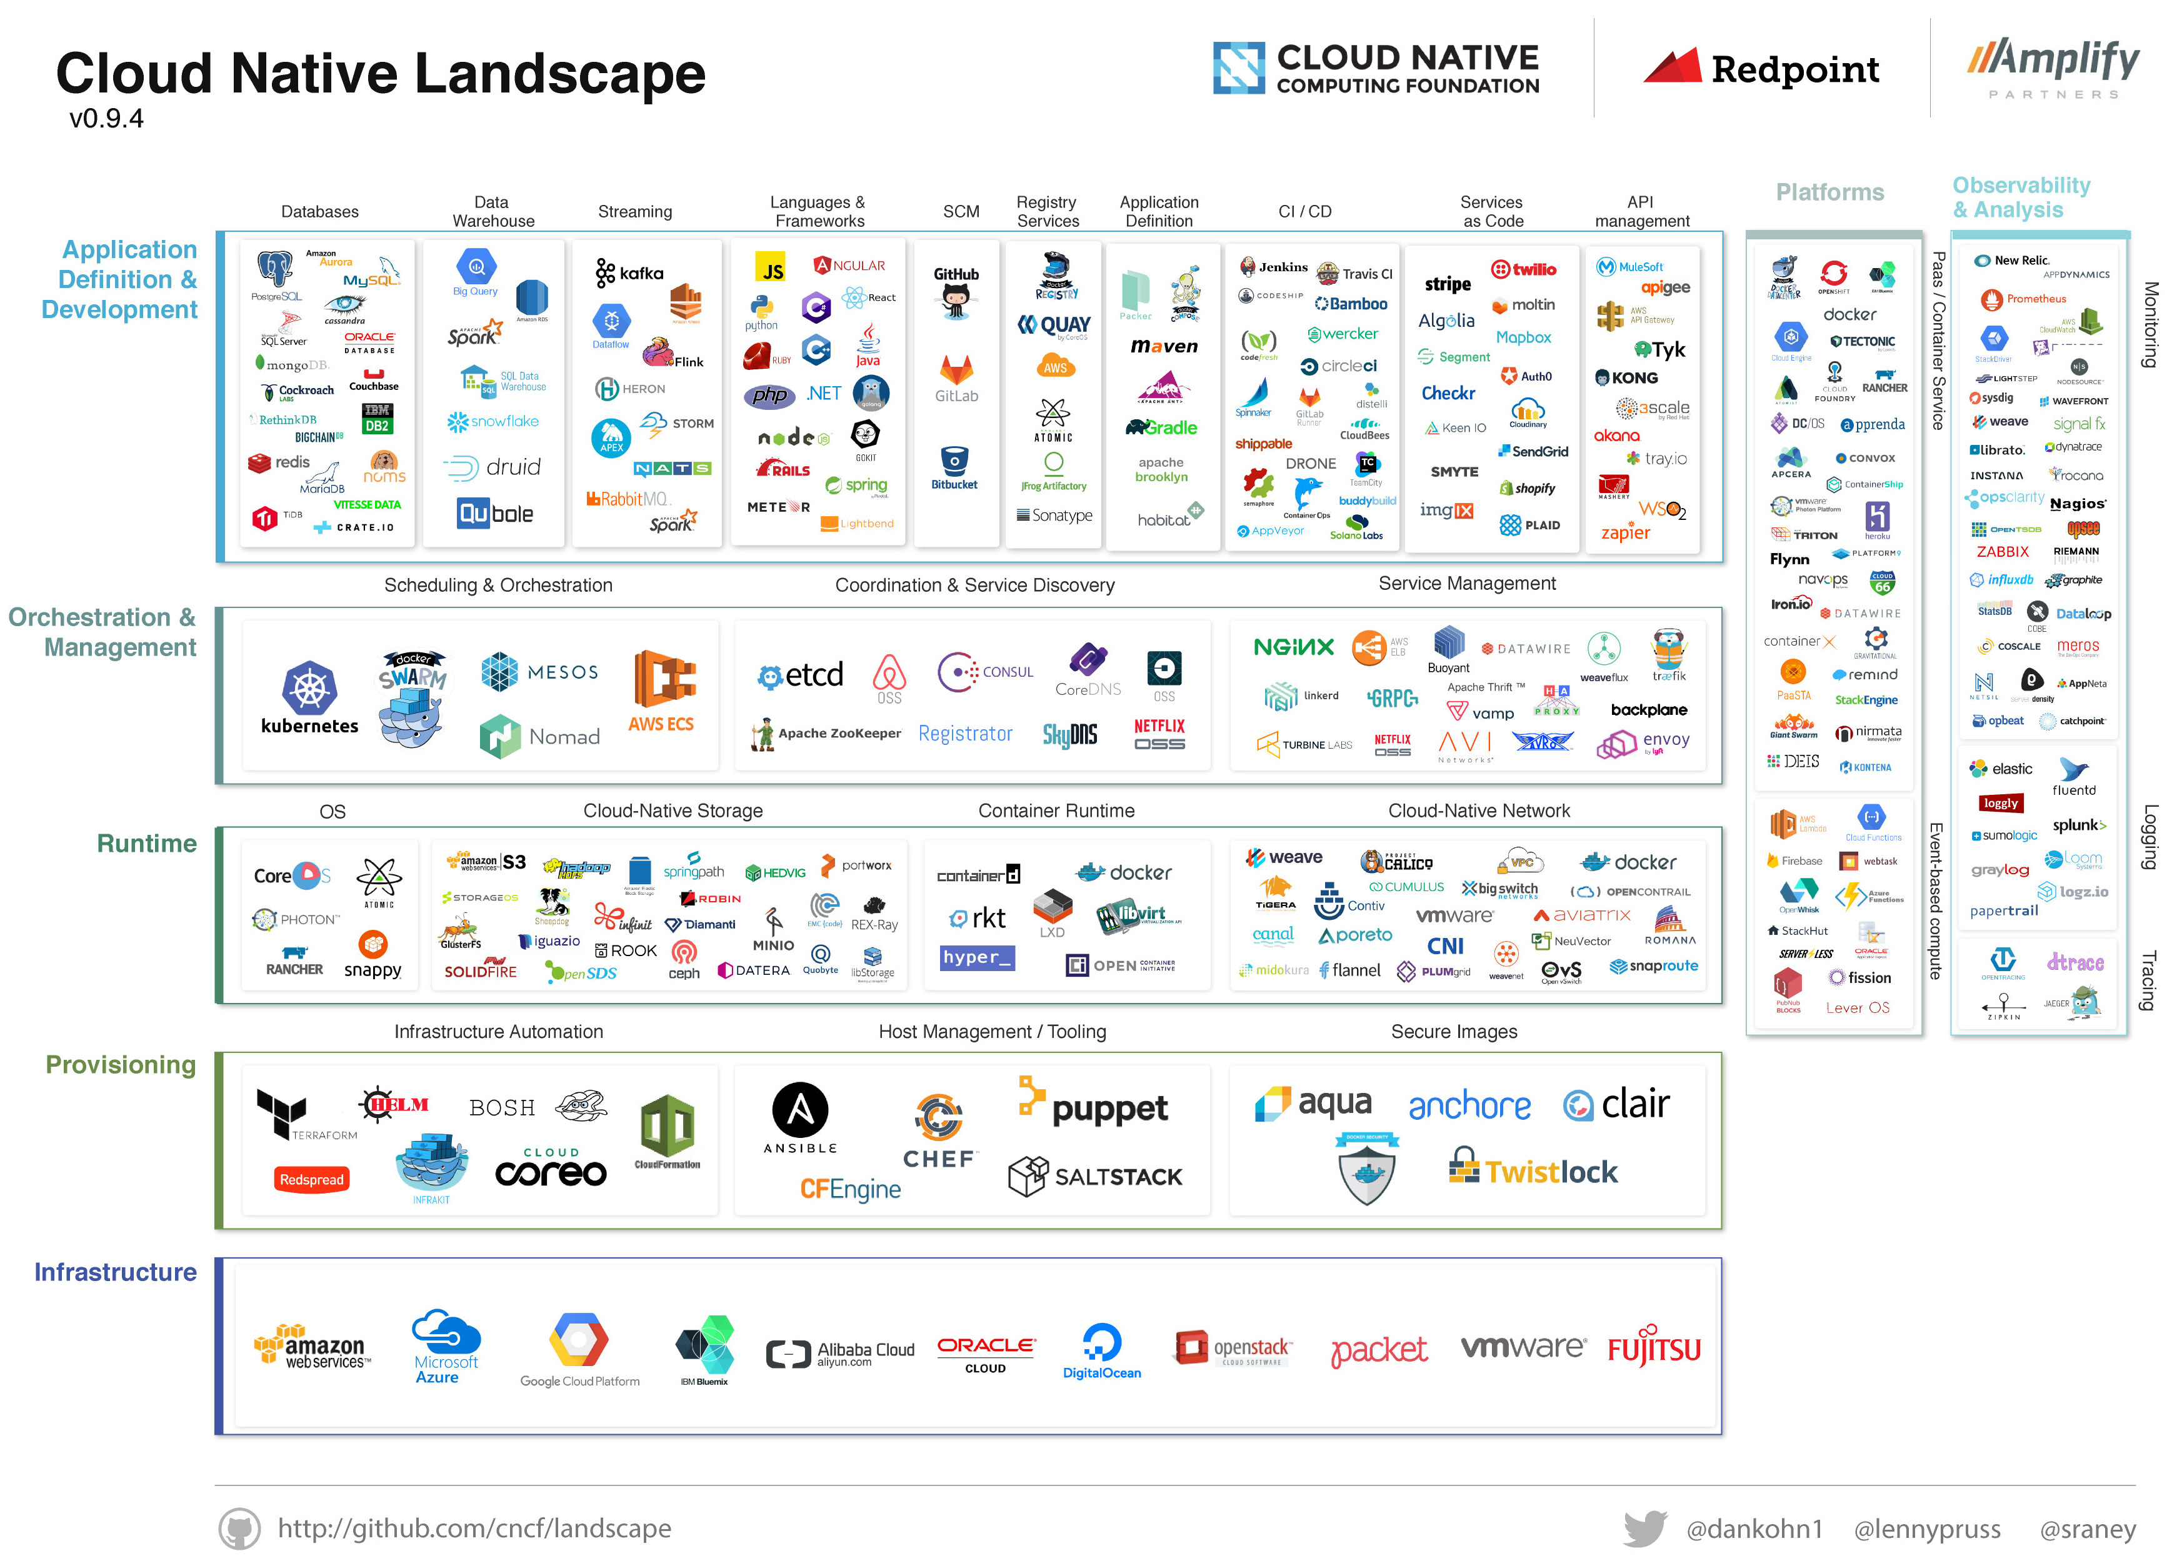
It’s about embrace
Cloud native systems must embrace:^{[1]}
Openness and extensibility
Well defined APIs and boundaries
Minimal barriers to application lifecycle
[1] https://www.cncf.io/about/charter/

Slide 7
It’s about principles
Must share three key attributes:^{[1]}
Container packaged
Dynamically managed
Micro-services oriented
[1] https://www.cncf.io/about/charter/

Slide 8
Next Stop: Micro-services
SERVERLESS
CLOUD-NATIVE
MEDIA MICRO-SERVICES
MEDIA SERVICE
CLOUD-NATIVE
MICRO-SERVICES
CONTAINERS
OPEN API
Rethinking the way we plan and build applications.
CN PLATFORM

Slide 9
Most of today’s media services are typical monolith applications running on virtualized environments
Pipeline Manager
Transcoder
Queue manager
Virtual Machine
Media moving
Business rules
Profile
Media processing engine
CLOUD INFRASTRUCTURE

Slide 10
A media transcoding service would composed by independent, self contained, stateless micro-services
Media Transcoding Service
Queue manager
Container
Media moving
Business rules
Profile
Media processing engine
CLOUD INFRASTRUCTURE

Slide 11
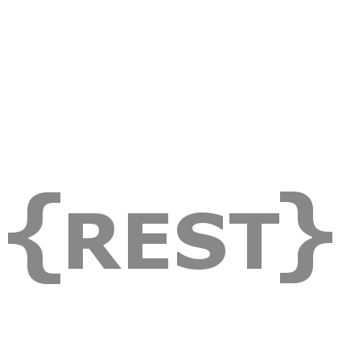

When designing micro-services, If you have to know about surrounding services you don’t have a bounded context
1080p
3Mbps
720p
2Mbps
1080p
3Mbps
480p
1Mbps
360p
900Kbps
240p
400Kbps

Slide 12
ROUTE 1: CONTAINERS
SERVERLESS
CLOUD-NATIVE
MEDIA MICRO-SERVICES
MEDIA SERVICE
CLOUD-NATIVE
MICRO-SERVICES
CONTAINERS
OPEN API
CN PLATFORM
A route with a considerable deal of container infrastructure workload and skills required

Slide 13
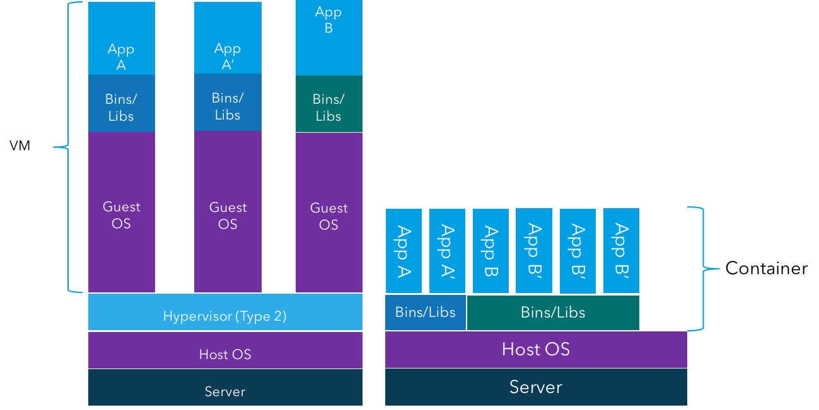
Containers are a step forward on hardware virtualization and provides seamless portability to micro-services applications.
Less overhead CPU intensive workloads *
As less as 50% memory utilization *
4x higher disk throughput *
Milliseconds startup time **
(*) Chaufournier, Lucas, Sharma, Prateek, Shenoy, Prashant, Tay, Y.C., “Containers and Virtual Machines at Scale: A Comparative Study”, December 2016
(**) Schipp, John, “Some Docker Performance Tests”, article, no published date, http://www.draconyx.net/articles/some-docker-performancetests.html

Slide 14
Containers are key elements of a Cloud-native system
Containers provide an important foundation where cloud native landscape develops
Container orchestration enables
Provisioning container
Managing container dependencies
Enabling discovery
Handling container failure
Scaling containers
…

Slide 15
Geography spanning container orchestration equals to unparalleled distributed media micro-services.
PRIVATE CLOUD
DEDICATED / SHARED PUBLIC CLOUD

Slide 16

The level of resiliency that enables us to literally embrace the chaos
”…If we aren’t constantly testing our ability to succeed despite failure, then it isn’t likely to work when it matters most – in the event of an unexpected outage.”
Source: http://techblog.netflix.com/2010/12/5-lessons-weve-learned-using-aws.html
http://blog.inin.com/building-to-fail-a-success-story

Slide 17
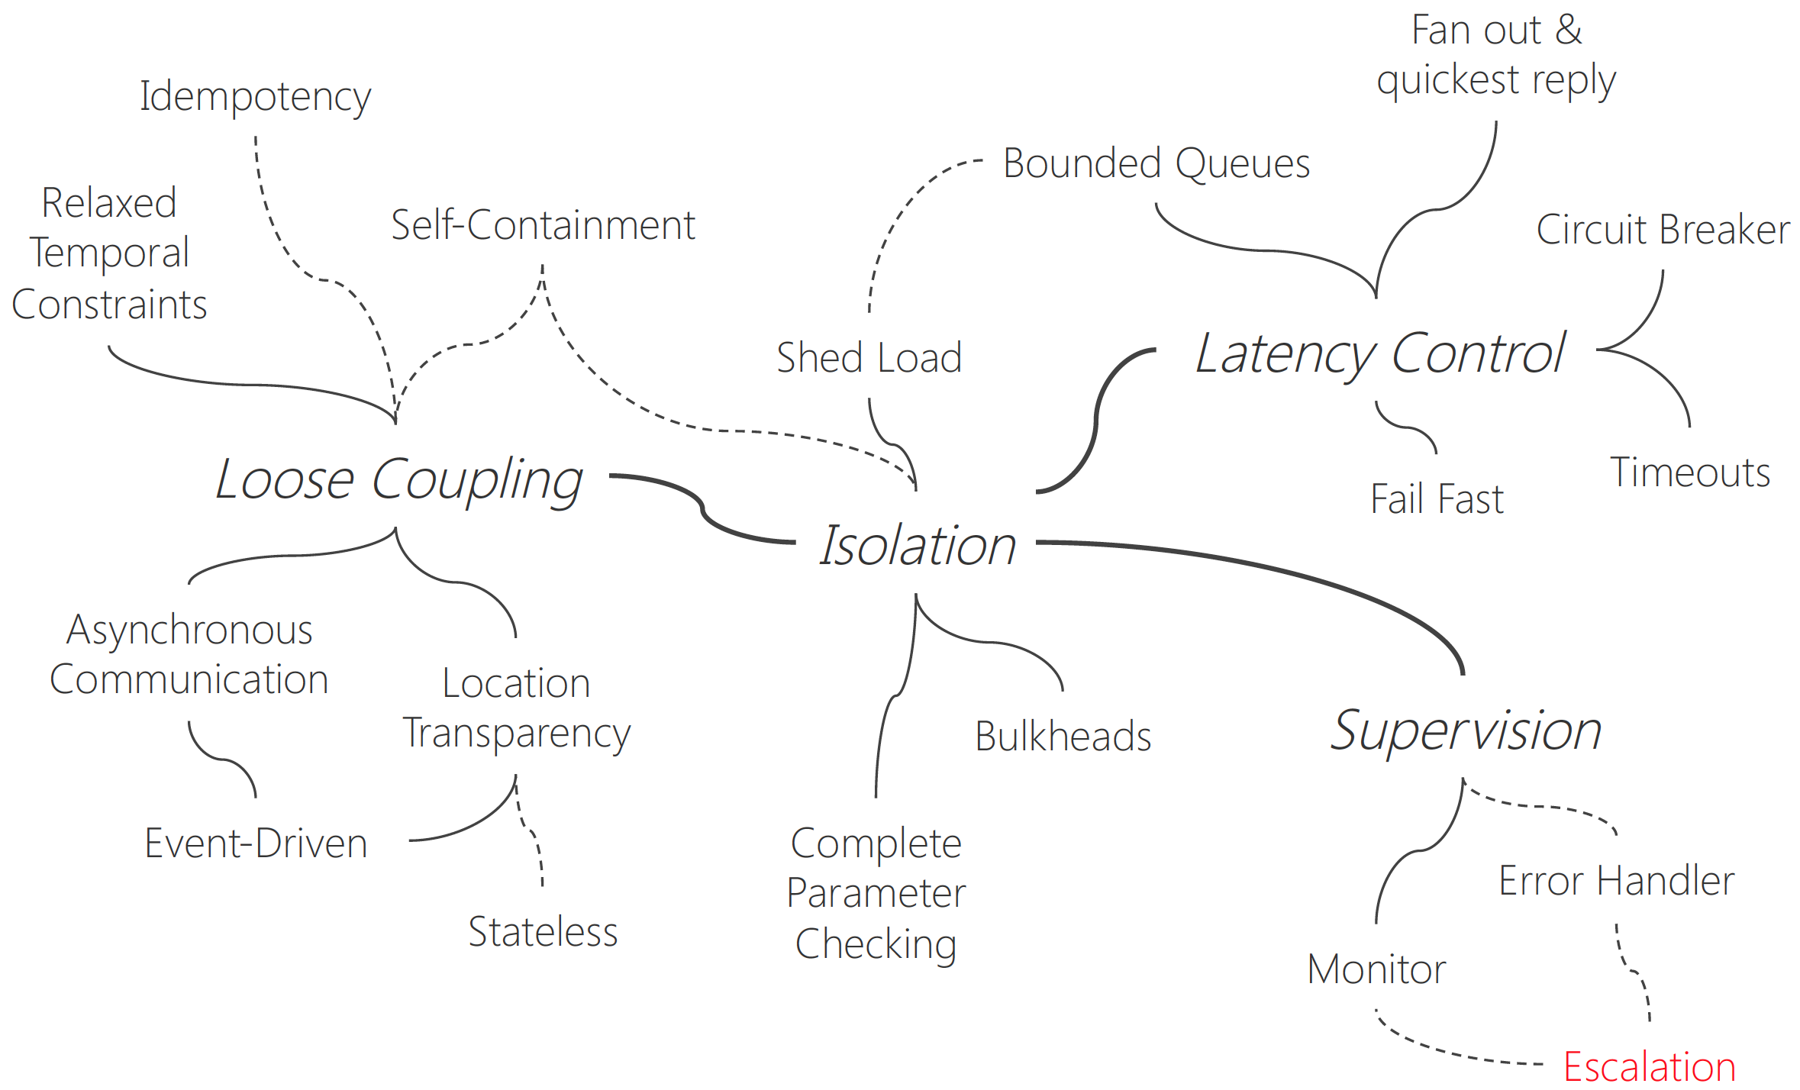
But it does not happen as magic! It comes along with a great deal of new application dev paradigms
Resilient design patterns
Source: Patterns of Resilience - Uwe Friedrichsen - http://slideshare.net/ufried

Slide 18
ROUTE 2: cloud-native platform
SERVERLESS
CLOUD-NATIVE
MEDIA MICRO-SERVICES
MEDIA SERVICE
CLOUD-NATIVE
MICRO-SERVICES
CONTAINERS
OPEN API
Less dealing with containers infrastructure but is offering dependent
CN PLATFORM

Slide 19
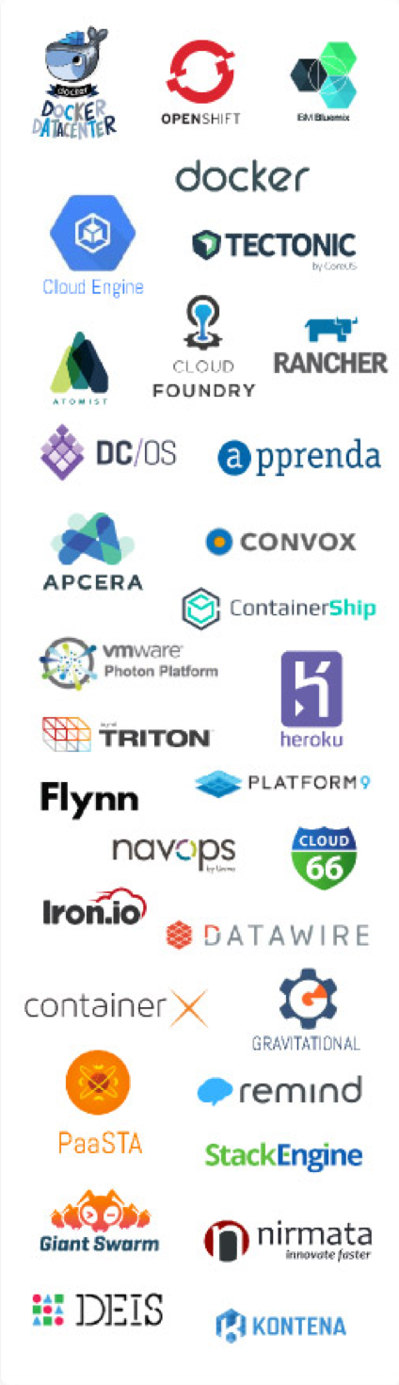
PaaS and Container Services
We may choose this route, considering some pros and cons
Less dealing with infra.
Pre built runtimes and services
Pre built orchestration and resilience
Dependency on platform offerings for public platforms

Slide 20
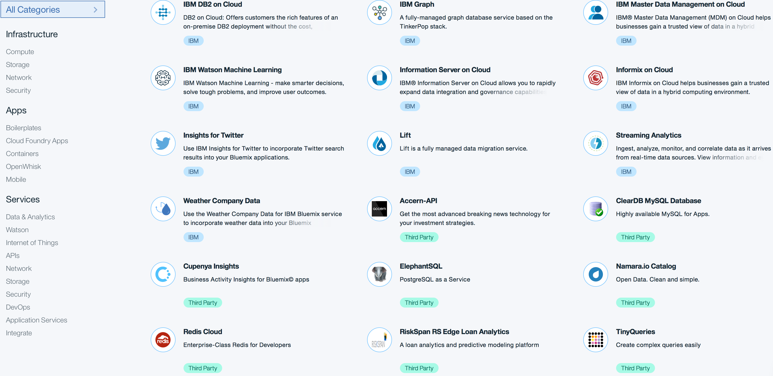
Cloud-native PaaS are a playground for building systems. Each provider has a list of owned and 3rd party runtimes and services.

Slide 21
ROUTE 3: SERVERLESS
SERVERLESS
CLOUD-NATIVE
MEDIA MICRO-SERVICES
MEDIA SERVICE
CLOUD-NATIVE
MICRO-SERVICES
CONTAINERS
OPEN API
Complete infrastructure independency
CN PLATFORM

Slide 22
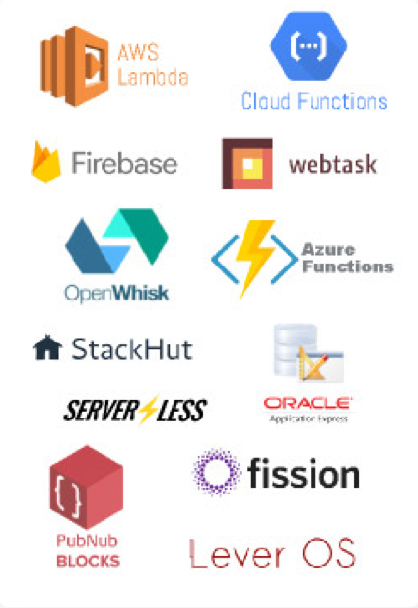
Event driven, serverless architectures
Today’s highest level of infrastructure abstraction.
Code-only, multi-language, environment
Event chain models to build new services
Fast track to new workflows and products
Package offerings need to be developed
There’s no cross vendor syntax

Slide 23
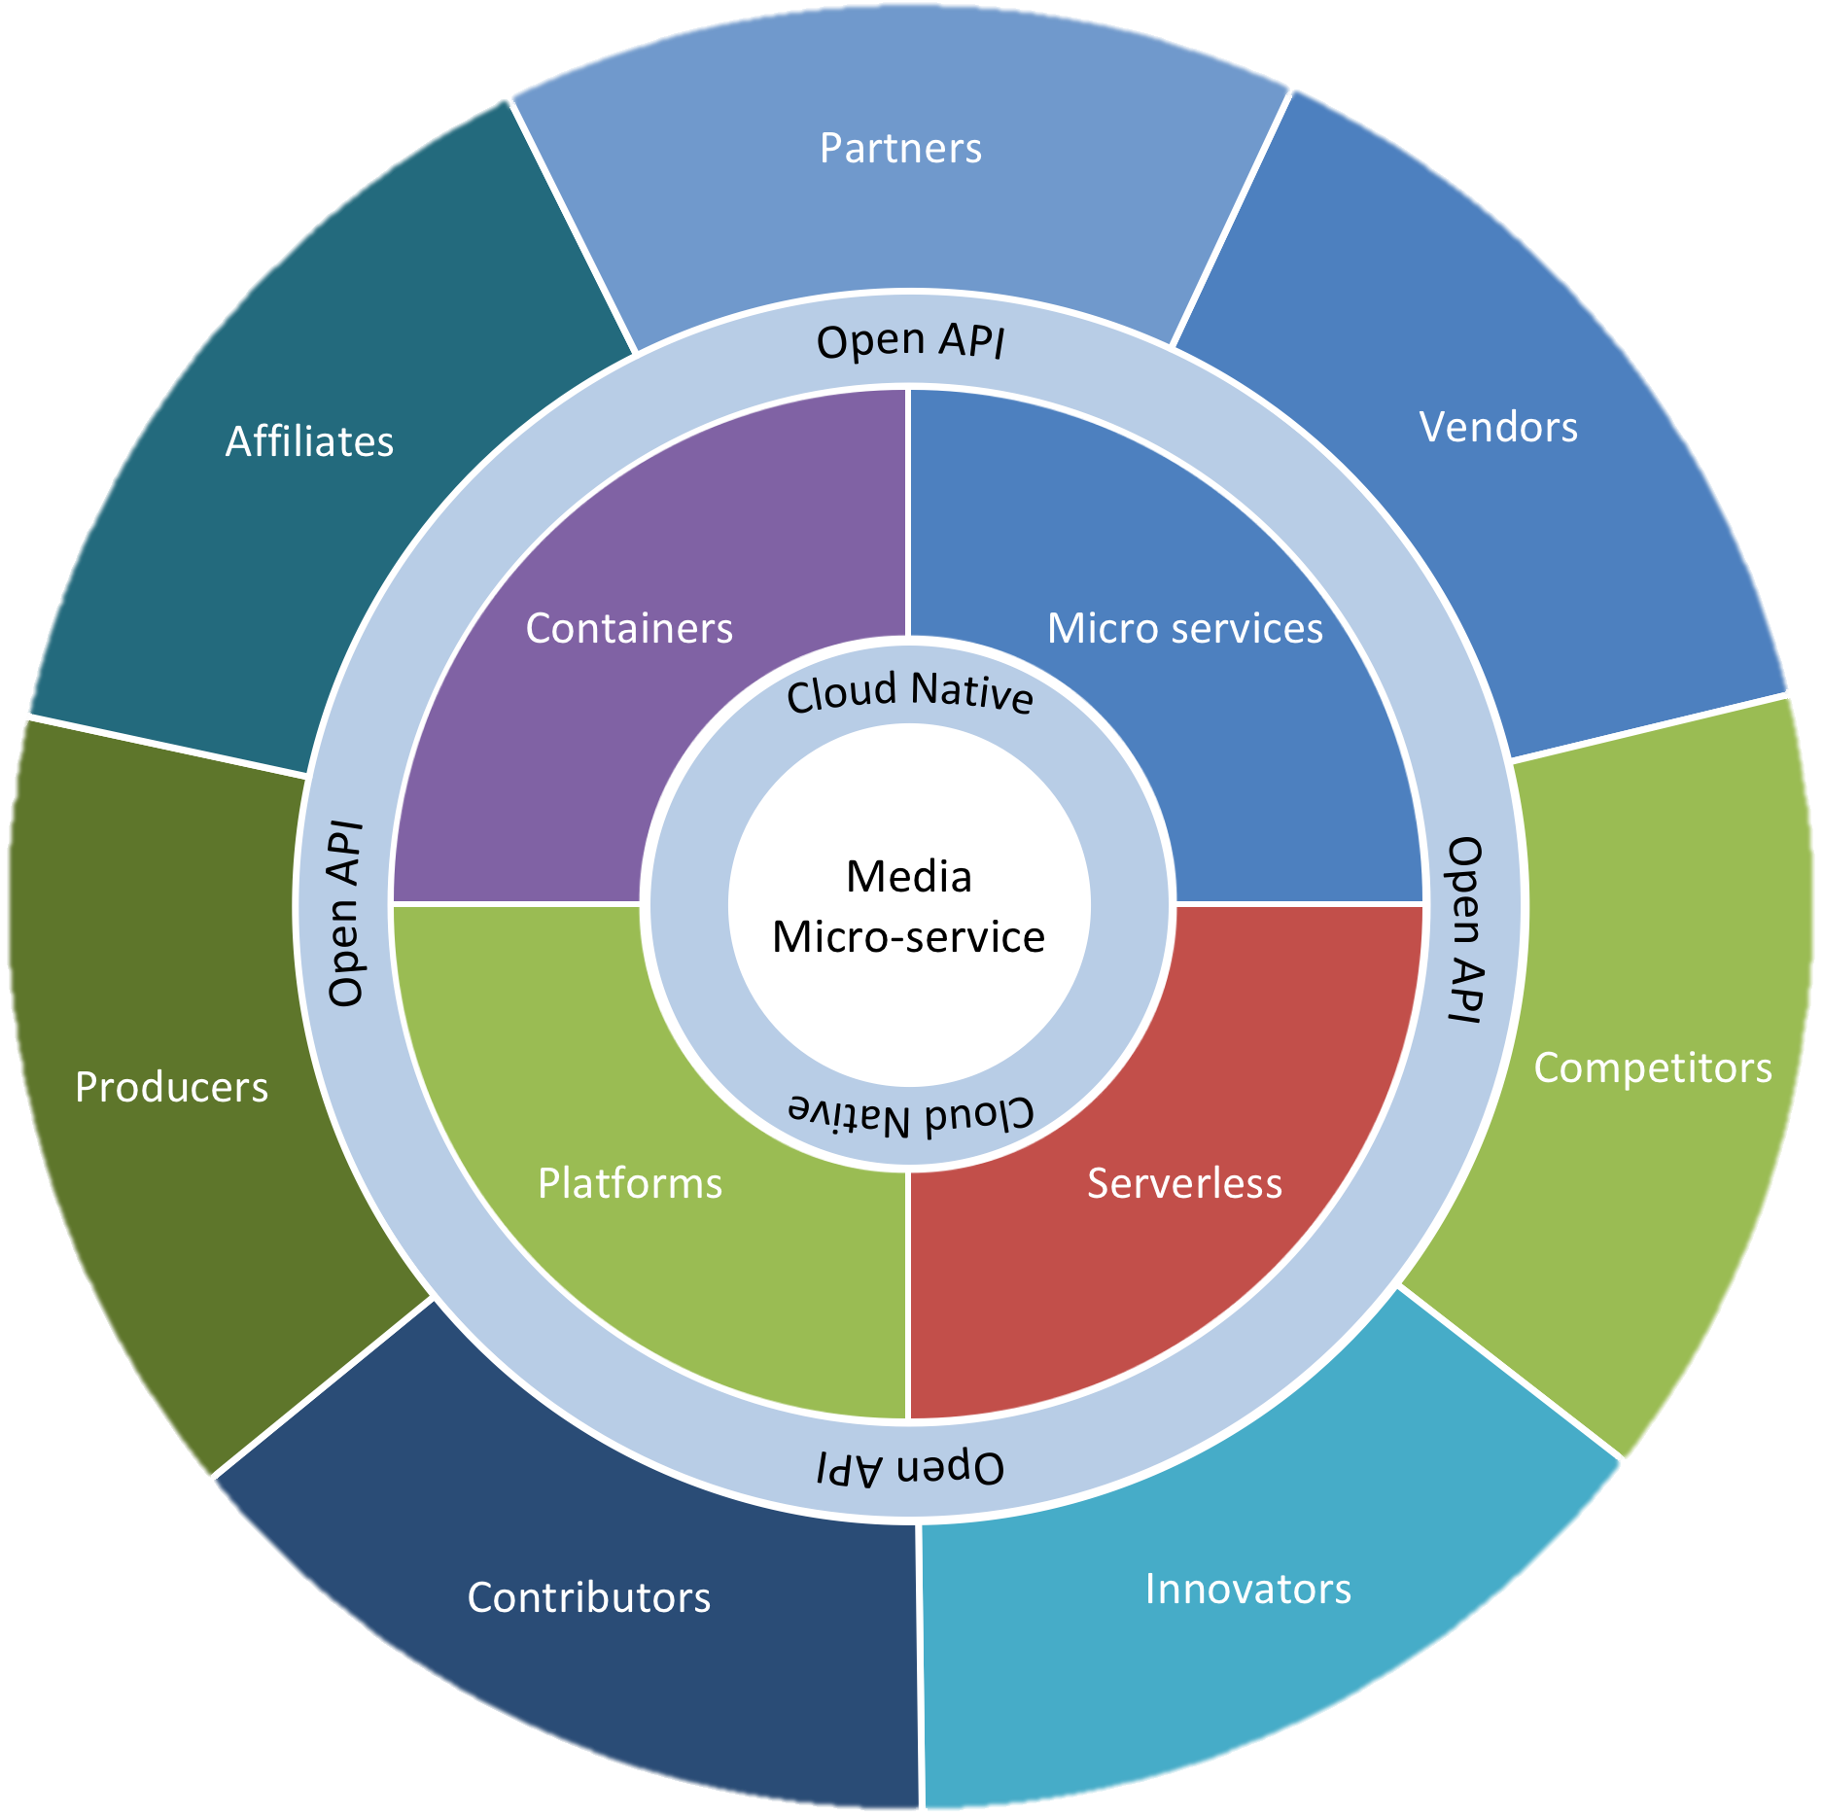
OPEN API
CLI | SDK | UI
Media
Micro-services
Ecosystem
Services
Ecosystem
Packages
OPEN API
Transcoding
OPEN API
Feed
Trigger
Action
Rule
Actions
Invoke
NodeJS
DRM
Action
Action
Action
Feed
Trigger
Rule
Chain
Chain
Actions
Invoke
Swift
NodeJS
Docker
Content Ordering
Action
Rule
Feed
Trigger
NodeJS
Actions
Invoke

Slide 24
LAST COMMUTE: OPEN API TO MEDIA MICRO-SERVICES
SERVERLESS
CLOUD-NATIVE
MEDIA MICRO-SERVICES
MEDIA SERVICE
CLOUD-NATIVE
MICRO-SERVICES
CONTAINERS
OPEN API
Decidir se vai abordar platform
CN PLATFORM

Slide 25
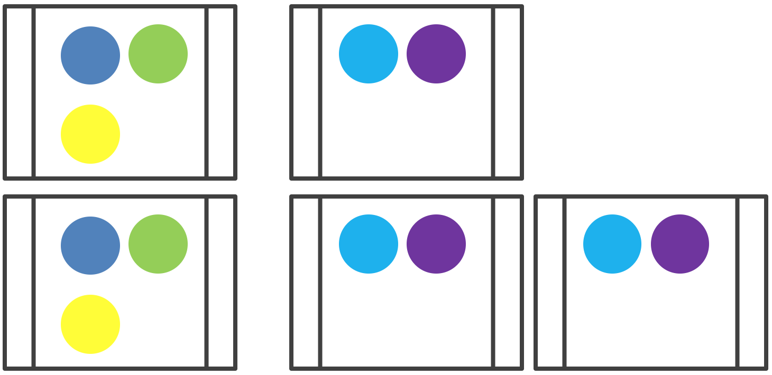

Without open APIs there’s no Cloud-Native System. It is the key enabler for ”openness and extensibility”^{[1]}
FROM CLOSED APIs
TO OPEN APIs
Innovators
API
Employees
B2B
Content Producers
API
API
API
API
API
API
Competitors
API
API
Suppliers
API
API
ISVs
API
API
WEB
FTP
Partners
API
API
API
Unknown Parties
API
API
Known Parties
API
API
EDI
API
API
API
API
API
API
[1] https://www.cncf.io/about/charter/

Slide 26
Pre-defined integration points
Opportunistic access points
Limited trusted partners
Many partners, untrusted
Strictly constrained interactions
Encourage new ideas
Enterprise Friendly
Developer friendly
FROM CLOSED APIs
TO OPEN APIs
Innovators
API
Employees
B2B
Content Producers
API
API
API
API
API
API
Competitors
API
API
Suppliers
API
API
ISVs
API
API
WEB
FTP
Partners
API
API
API
Unknown Parties
API
API
Known Parties
API
API
EDI
API
API
API
API
API
API
[2] Cloud Native Middleware Microservices - 10 Lessons Learned, Kai Wähner, April 7, 2017, https://www.slideshare.net/KaiWaehner/cloud-native-middleware-microservices-10-lessons-learned

Slide 27
CONCLUSION
Challenges are plenty, there’s still quite a long road both business and technology wise. But the benefits on business agility and flexibility provided by cloud native applications worth the journey!

Slide 28
Businesswise, there are more questions than answers while we ride this journey
Large scale cloud native solutions require deep skill set not typically available on most vendors and media companies.
Which companies will be the cloud native media micro-services providers of the future?
Will vendors of today have the investment power to pursue such journey?
How much are our customers willing to outsource media services?
How important is the role of media services on companies’ competitive differentiator?
Will outsourcing media services commoditize the sector?
How much will vendors be willing to embrace that?

Slide 29
A media micro-service centric model to unleash benefits to vendors and media companies.
Will disrupt the boundaries of business models by securely exposing composable media services at scale.
There will be no market reach limitation since cloud native media services will distribute resiliently across geographies.
Down to the minute pay as you go service model will enable a variety of micro content licensing and distribution.
No more lock-in to media sector specific vendors.

Slide 30


Thank you!
SERVERLESS
CLOUD-NATIVE
MEDIA MICRO-SERVICES
MEDIA SERVICE
CLOUD-NATIVE
MICRO-SERVICES
CONTAINERS
OPEN API
CN PLATFORM
/WasCabral/cloud-native-media
http://cloud-native-media.

